Slide 1
Machine learning enhanced building-Based disaggregation model for reginal near-real-time CO2 emission estimations

Slide 2
Input: various emission inventory
Emission disaggregation model

Slide 3
Map Module
Region define
Polygon layer
District layer
Raster layer
Building layer

Slide 4
Building Module
Data organizer
Dataset
Prediction with ML
Import polygon
Non-raster values:
Polygon
Type,
Height
Target and feature setting
Repair polygon
Train data selecting
One Building
Assign raster value
Train model
Raster values:
LCZ,
GHSL,
Nightlight,
3D map
Model evaluate
Assign ML model value
Prediction

Slide 5
Emission parameter

Slide 6
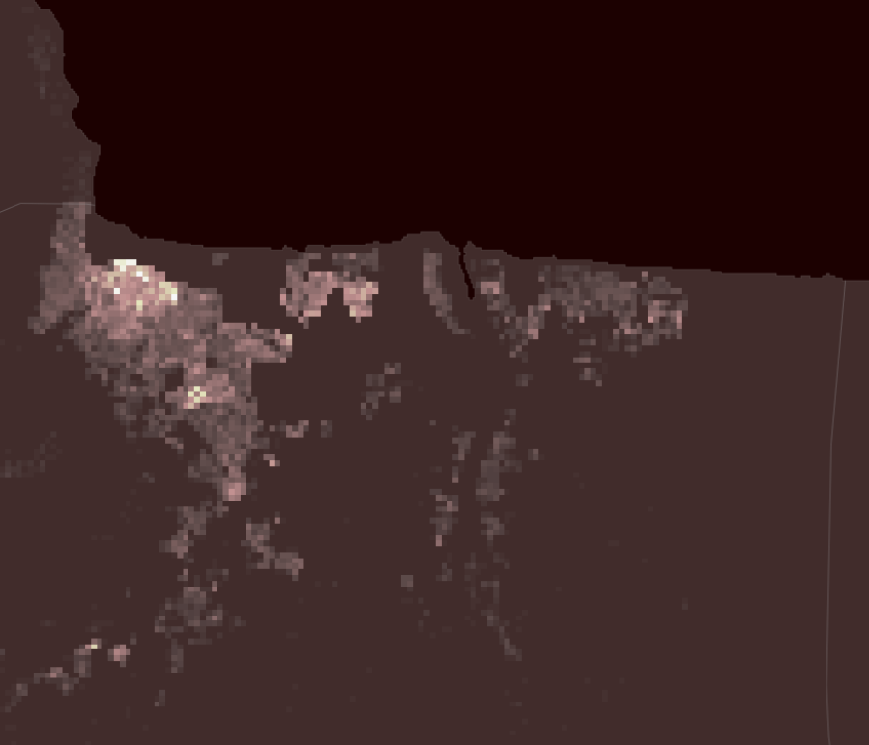

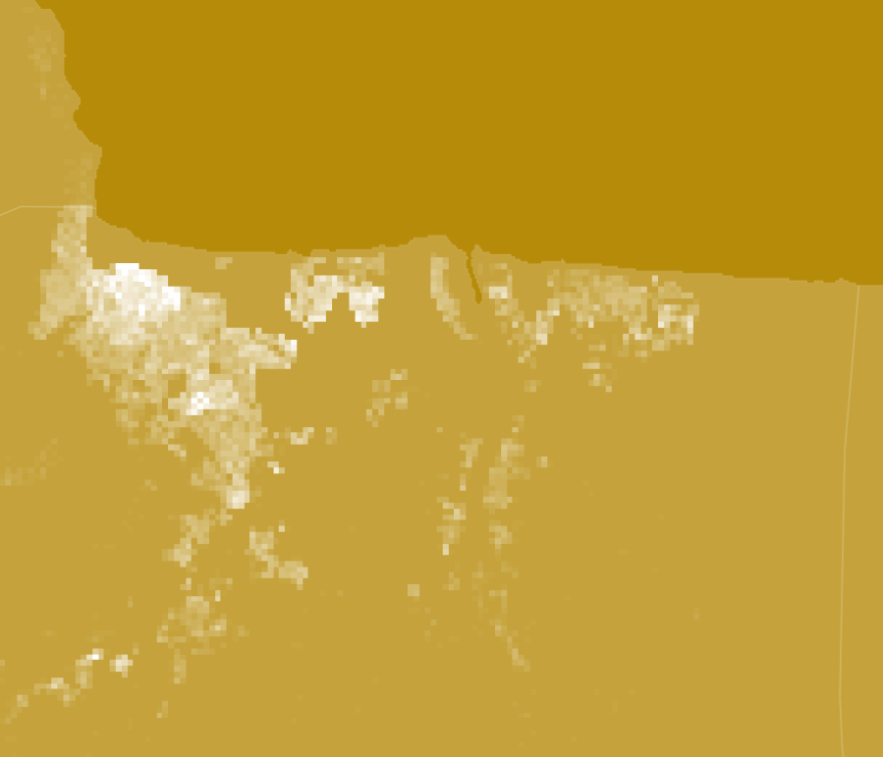
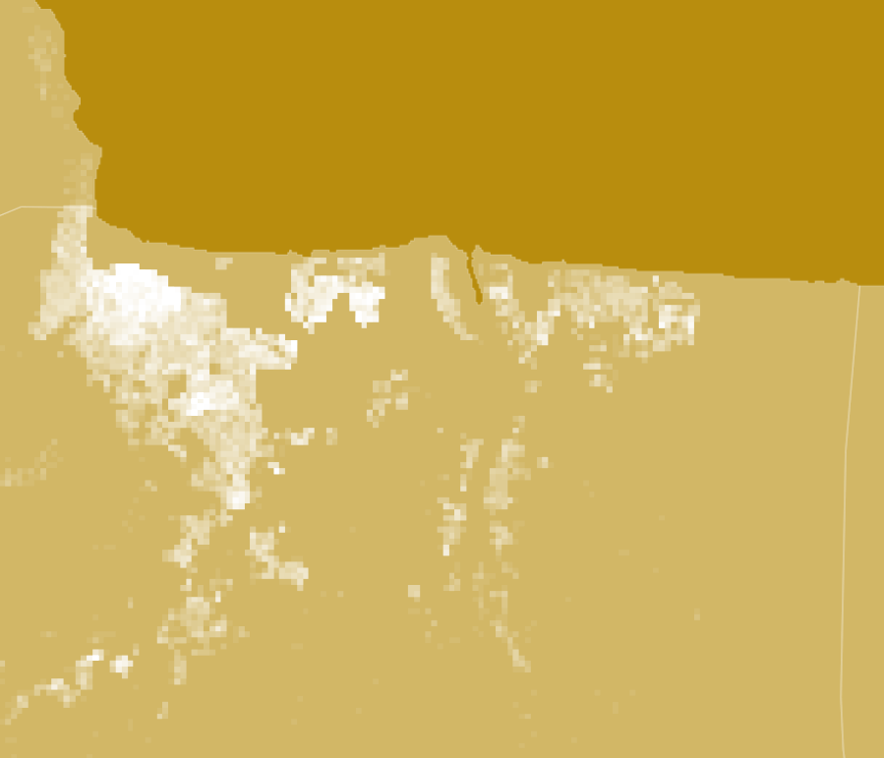
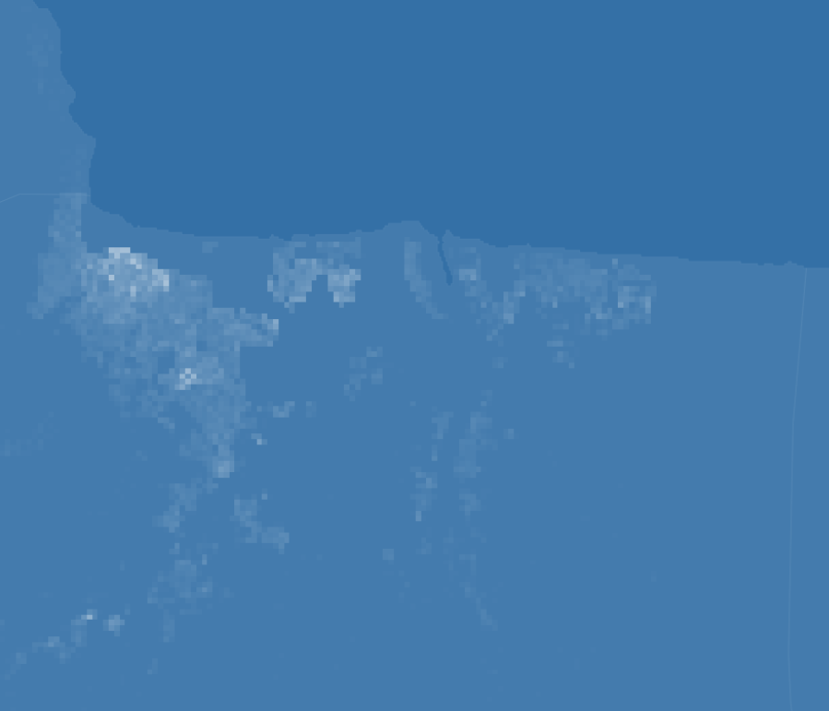
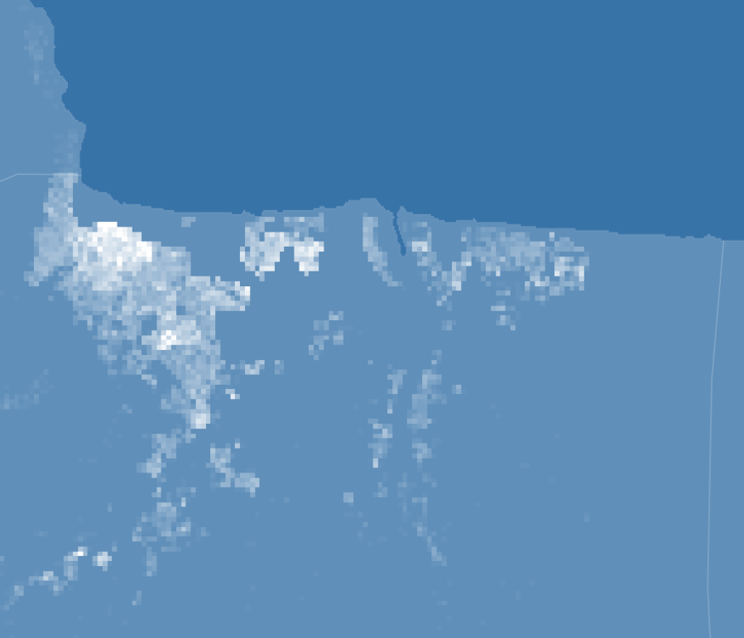
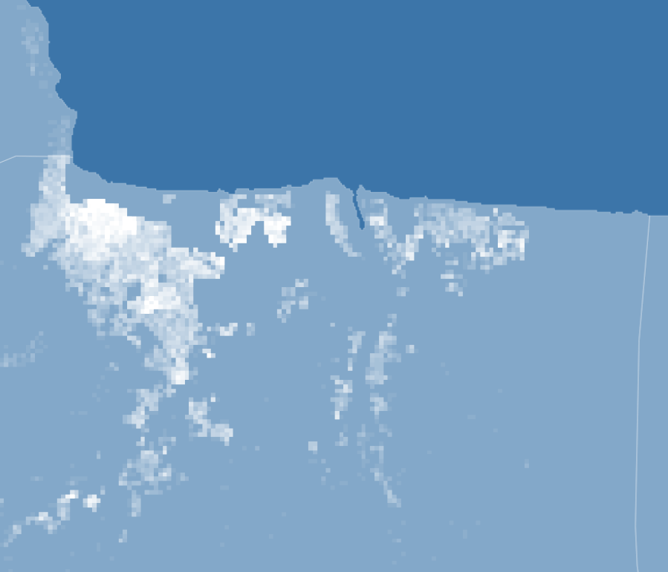
Near-real-time Grid CO2 Emission = f(Total Emission, Spatial Modifier, Temporal Modifier)
Spatial Modifier
The base emission for the grid
Total near-real-time
CO2 Emission
Near-real-time Grid CO2 Emission
f(building, household, population, land use type, heating/cooking source, …)
Temporal Modifier
The emission varied with time for the grid
Total regional emission from carbon monitor database
100*100 m
f(electricity, nightlight, surface temperature, air temperature, …)

